Slide 1
2020 2D Motion Test Review
CP with Honors Additions at the End

Slide 2
1a. 23 m/s east is a vector. What are the two parts that make up a vector?
Underlined is the ________________
Bolded is the ____________________
1b. Rewrite the information in 1a as a scalar quantity
2a. Which vector has the greatest south component?
2b. Which vector has the greatest magnitude?

Slide 3
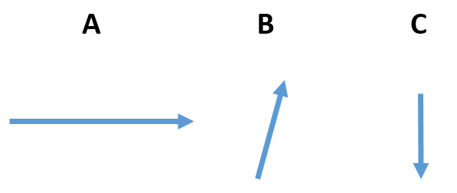
2a. Which vector has the greatest south component?
2b. Which vector has the greatest magnitude?

Slide 4
3. A bird is flying horizontally when it drops a fish. 3a. Draw the path the fish would take. 3b. This shape is called a _______________________
3c. When would the bird have to drop the fish to hit the target? (before, directly above, or after)
3d. Where will the bird be when the target is hit? (before, directly above, or after)

Slide 5
Horizontal Projectile Motion Practice
4. A bird is flying at 25 m/s when it drops the fish that falls 90 meters to the water.
4a. How long does it take the fish to fall to the water?
4b. How fast is the fish traveling vertically when it hits the water?
4c. How far horizontally forward will the fish land?

Slide 6
Horizontal Projectile Motion Practice
4. A bird is flying at 25 m/s when it drops the fish that falls 90 meters to the water.
4d. What variable information was given in the question which was required to determine how far out the fish would land?
4e. Would the mass of the fish affect the time it takes to hit the ground?

Slide 7
5. Give three examples of a projectile?

Slide 8
6a. What happens to horizontal velocity after a projectile is launched horizontally?
6b. What happens to vertical velocity after a projectile is launched horizontally?
6c. Which is effected by gravity? (vertical motion or horizontal motion)

Slide 9
7a. You throw a ball forward at 20 m/s from a height of 1 meter. How much time would it take to hit the ground?
7b. You drop a ball from a height of 1 meter. How much time would it take to hit the ground?
7c. The faster you throw a ball horizontally (increases, decreases, does nothing) to the time it takes to hit the ground?
0.447 s
0.447 s

Slide 10
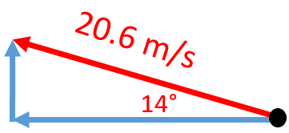
8a. What would be the complete description of the vector drawn here?
8b. What is the horizontal component of the vector drawn here?
8c. What is the vertical component of the vector drawn here?

Slide 11
9. What is the resultant of going 35 m west followed by 60 m north? Draw a complete vector diagram with arrow tips. Give a complete answer with magnitude, direction, and description of that direction.

Slide 12
10. What angle would you shoot a projectile to have it reach the furthest distance downrange?

Slide 13
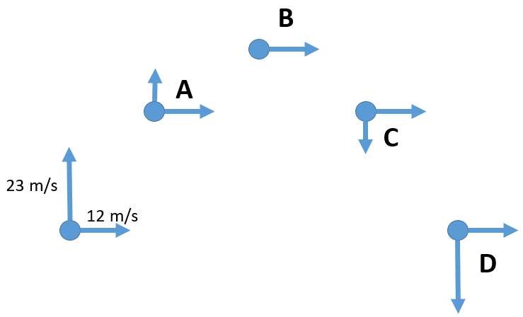
11a. What is the horizontal velocity at C in the projectile diagram?
11b. Where is the minimal velocity and what would that be?
11c. What is the vertical velocity at point D?
11d. What is the horizontal velocity at point D?
11e. What is the acceleration at B?
11f. What is the vertical velocity at B?

Slide 14
11g What is the horizontal acceleration when the ball maintained a constant horizontal velocity of 12 m/s for 4.6 seconds?
11h what is happening to the vertical speed on the way up?
11i. What is happening to the vertical speed on the way down?

Slide 15
Honors Addition
12. Add the following vectors and to determine the overall resultant.
45 m 20° North of East and 80 m North

Slide 16
13. A soccer ball is kicked at 30 m/s 28° above the ground.
13a. Draw the vector triangle
13b. What is the horizontal velocity?
13c. What is the initial vertical velocity?

Slide 17
13. A soccer ball is kicked at 30 m/s 28° above the ground.
13d. What is the highest point the soccer ball will reach?
$$v_{f}^{2}=v_{i}^{2}+2ax$$
$$v_{fy}^{2}=v_{iy}^{2}+2gy$$
X
Y
$$0^{2}={14.08}^{2}+2(−10)y$$
v_{x} = 26.49 m/s
v_{iy} = 14.08 m/s
$$0=198.25−20y$$
g = - 10 m/s²
y = ?
$$−198.25=−20y$$
v_{fy} = 0 m/s
$$y=\frac{−198.25}{−20}$$
$$y=9.91 m$$

Slide 18
13. A soccer ball is kicked at 30 m/s 28° above the ground.
13e. How far downrange will the soccer ball land?

